Slide 1
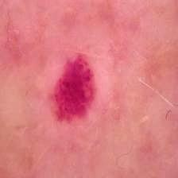
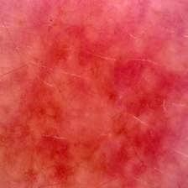
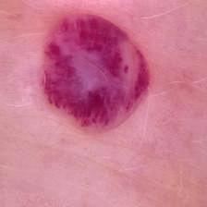
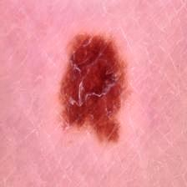
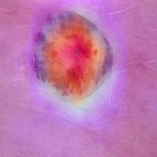
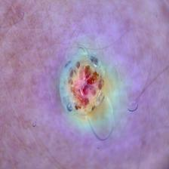

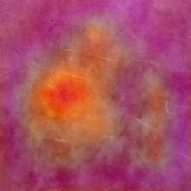
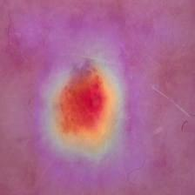
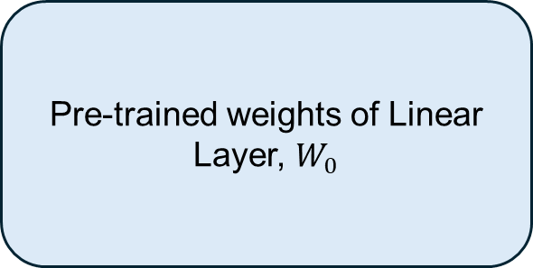
HAM10000 Dataset
Augmentation
Horizontal and vertical flips
Rotation, scaling, translation, shear
Elastic deformation
Gaussian blur
Contrast and brightness adjustment
Hue and saturation shift
Coarse dropout occlusion
Resize Image
Contrast Limited Adaptive Histogram Equalization (CLAHE)
Min-Max Scaling
Classified Output
Classification Head
mel
nv
vasc
CBAM
BLock
Xception Model Block
akiec
bcc
bkl
df
Global Max Pooling
Dense Layer
Dropout
L1 & L2 Regularization
SoftMax
GradCam++ Image
Dataset (347 IMG)
Proposed Dataset
Original image
Grad-CAM++ heatmap image
Predicted class
Morphological description of the image
Expert’s Annotation
with textual descriptions
of morphological features
Input Features
Med-Gemma-4B Model
LoRA Adapter
Pre-trained weights of Linear Layer, $W_{0}$
A
r
B
Output Features/ Explanation of the Classifier Decision

Slide 2
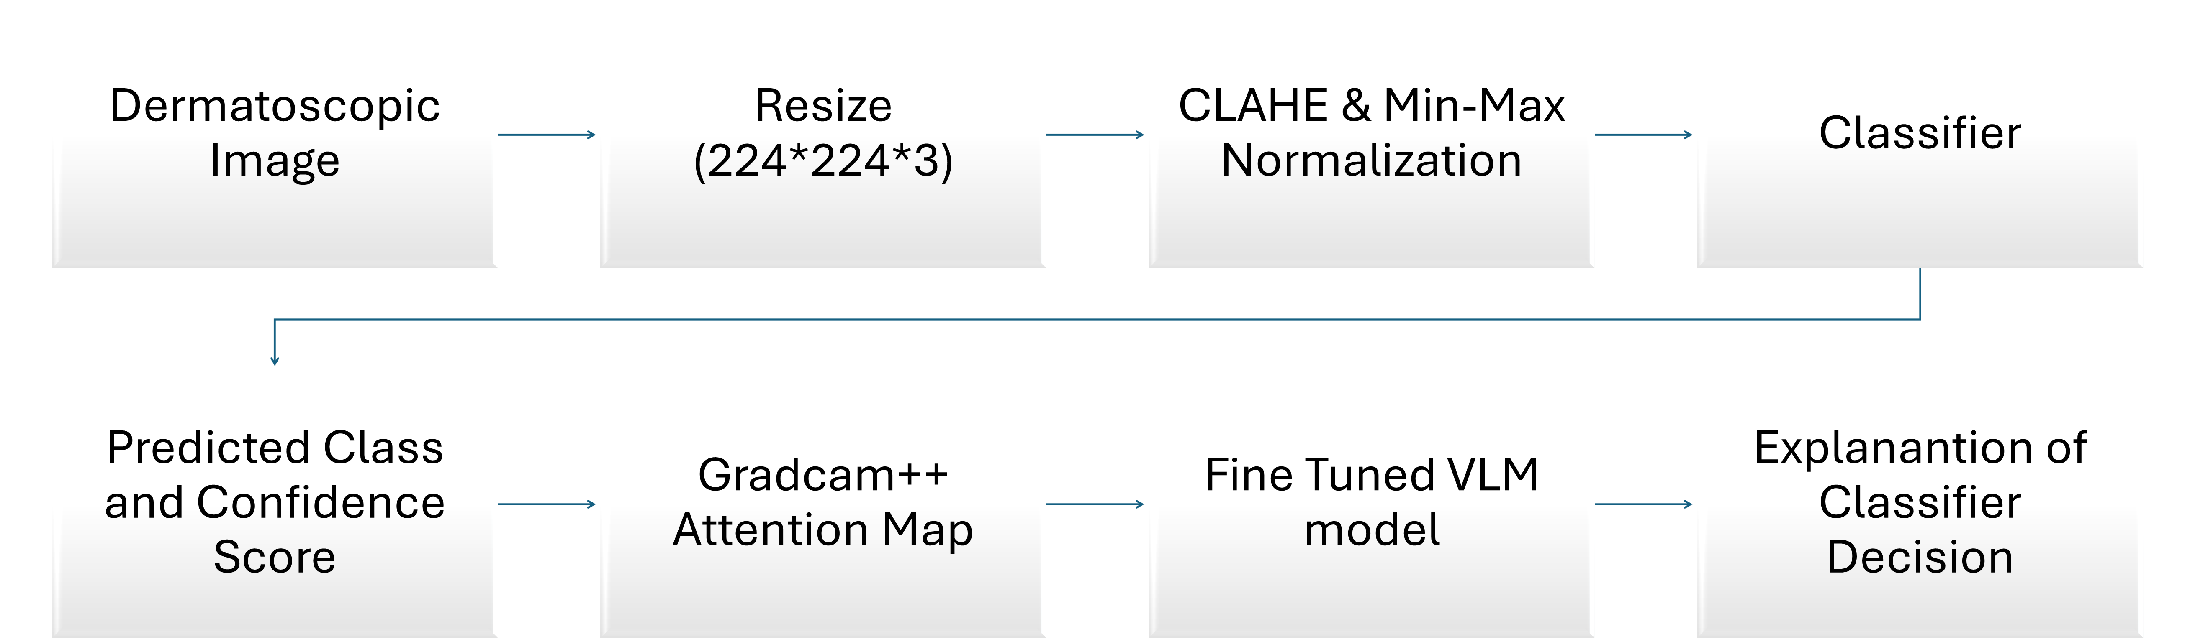
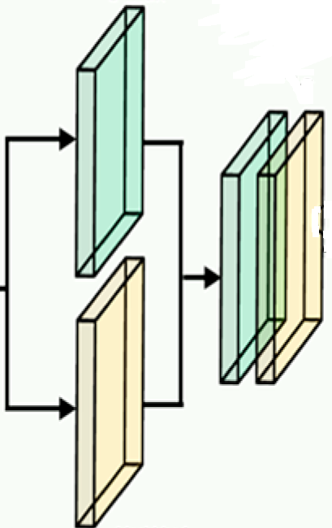
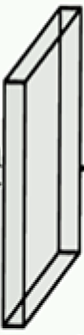


Entry Flow
3×3 SCONV
3×3 SCONV
3×3 CONV
3×3 CONV
ReLU
MaxPool
3×3 SCONV
3×3 SCONV
3×3 SCONV
ReLU
ReLU
ReLU
ReLU
MaxPool
ReLU
3×3 SCONV
Preprocessed Image
Input: 224×224×3
ReLU
MaxPool
1×1
CONV
1×1
CONV
1×1
CONV
Xception Model (Pretrained on ImageNet, First 50 Layers Frozen)
ReLU
3×3 SCONV
3×3 SCONV
MaxPool
ReLU
ReLU
3×3 SCONV
ReLU
ReLU
3×3 SCONV
3×3 SCONV
ReLU
(7, 7, 2048) feature map
3×3 SCONV
Middle Flow (Repeat 8 Times)
ReLU
1×1 CONV
3×3 SCONV
Exit Flow
Feature: H×W×C
Global max pooling
C/16
C
Global max pooling
Max pooling
H×W×1
1×1×C
Concatenation
H×W×2
H×W×1
conv
7×7
H×W×C
Global avg pooling
Global avg pooling
CBAM Layer
1×1×C
Convolutional
Feature H×W×1
Shared Dense
Layer
Element-wise Addition
Element-wise Product
Avg pooling H×W×1
Sigmoid Activation
Softmax Layer
ReLU
Classified Output with
Confidence Score
Dropout = 0.25
….
Dropout = 0.3
Fully Connected Layer
….
Global avg pooling
$n_{c}$ unit
$$128 unit$$
L1=1e-4, L2=1e-3
Dermatoscopic Image
Resize (224*224*3)
CLAHE & Min-Max Normalization
Classifier
Predicted Class and Confidence Score
Gradcam++ Attention Map
Fine Tuned VLM model
Explanantion of Classifier Decision

